Slide 1




EcoFurnish:
Sales Analysis Case Study

Slide 2

Business Introduction
EcoFurnish is a company specializing in eco-friendly furniture. It sources sustainable materials to create stylish, durable, and environmentally responsible furniture pieces.
The company operates both online and through physical stores across the country, offering a range of products from office chairs to bedroom sets.

Slide 3

Business Situation
EcoFurnish has employed you as a data Scientist/Analyst to help him understand how his business has performed over time. They have provided you with access to the database.
You will need to extract only data that is relevant to the analysis you are to do.

Slide 4
Task
Retrieve all customer's names alongside the quantity of product bought. Include customers who haven't made any purchases (if any).
Retrieve all sales_id, sale_date and customer_email. Include sales records without corresponding customer information (if any).
List all id of products sold along with the customer's first name
List all product name and cast their prices as text.
Retrieve all customers names(first and last) and show the sale amount of product purchases if available; otherwise, show “No amount” or 0.
List all products and show the total quantity sold, with 0 if no sales.
Retrieve the sale amount as a decimal with three decimal places.
Classify products based on their stock levels. Return the product name, category,and a label that indicates whether the product is "Low Stock" (less than 10 units),"Medium Stock" (10 to 50 units), or "High Stock" (more than 50 units)
extract the saleid,saledate and the sale year.
Return the sale ID, sale date, and a label indicating "Q1" (January to March),
"Q2" (April to June), "Q3" (July to September), or "Q4" (October to December).

Slide 5
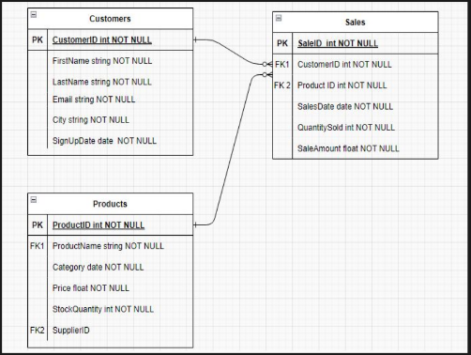
Data Overview
Customer:
Sales:
customerid
firstname
lastname
email
city
signup
signupyear
salesid
productid
customerid
saledate
quantitysold
saleamount
saleyear
Product:
productid
productname
category
price
stockquantity
supplierid
Link to Dataset

Slide 6



Data Querying language (DQL) Functions
Selection and Filtering statements:
SELECT: Used to retrieve data from one or more tables in a database, specifying the columns to be retrieved.
DISTINCT: Used in conjunction with SELECT to remove duplicate rows from the result set.
WHERE: Used to filter records that meet certain conditions, specifying criteria that must be met for rows to be included in the result set.
Grouping and Aggregation:
GROUP BY: Groups rows that have the same values in specified columns into summary rows, often used with aggregate functions to perform operations on each group of rows.
ORDER BY: Used to sort the result set of a query by one or more columns, with sorting done in ascending or descending order.
COUNT: Returns the number of rows that match a specified condition, often used with the GROUP BY clause.

Slide 7
JOIN
LEFT JOIN:
Combines rows from two tables, returning all rows from the left table and matching rows from the right table. If there's no match, the result is NULL for the right table's columns.
RIGHT JOIN:
Similar to a LEFT JOIN, but it returns all rows from the right table and matching rows from the left table. If there's no match, the result is NULL for the left table's columns.
INNER JOIN:
Combines rows from two tables based on a matching condition, returning only the rows where there is a match in both tables. If there is no match, the row is not included in the result.
FULL JOIN:
Returns Everything on both tables

Slide 8
CASE WHEN:
A conditional expression that allows you to return different values based on conditions. It's like an IF-THEN-ELSE statement in SQL.
COALESCE:
Returns the first non-NULL value from a list of arguments. It's useful for handling NULL values. Allows you replace missing values.
CAST:
Converts a value from one data type to another. For example, converting a string to an integer.
EXTRACT:
The EXTRACT function in SQL is used to retrieve specific parts of a date or time value, such as the year, month, day, hour, minute, or second.

